Slide 1
Crime In America

Slide 2
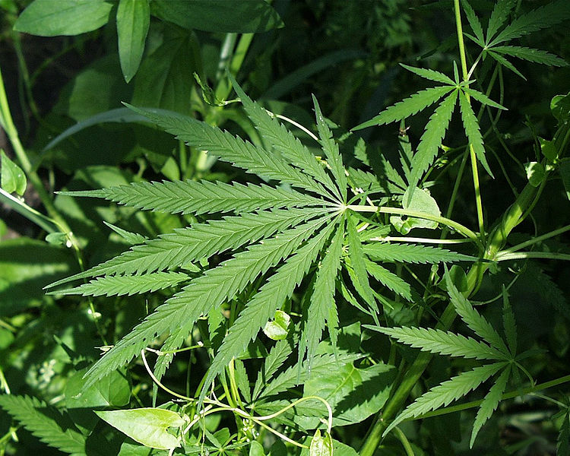
What Is Crime?
Something one does or fails to do that is in violation of the law
It is also a behavior for which the government sets a penalty

Slide 3
What is Crime
State Lawmakers Decide What Constitutes a Crime:
1) goal of criminal laws is to protect the public (not severely penalize someone for breaking it)
2) lawmakers base this on what is “right and proper for orderly conduct in society”
3) Napoleon had the foresight to create the Napoleonic Code of Laws in late 1700’s….the first of its kind.
Armed robbery presents a threat to safety and wealth in our society

Slide 4
Trying to Prevent Crime
Crime is often unpredictable
1) no clear cut-way of determining when crimes will occur
2) cops can get tips or they use informants, but many crimes are committed in the heat of the moment.
Since we don’t have those freaky kids to tell us when/where crime will occur like Tom Cruise did in Minority Report, criminal acts remain unpredictable!

Slide 5
Crime Prevention
2) We can try to profile behaviors in individuals which may lead to criminal actions later
In the novel/film The Silence of the Lambs, incarcerated serial killer Dr. Hannibal Lecter (above) is asked to give his analysis on how to catch current serial killer

Slide 6
Crime Prevention
We may work in prevention groups to stop crimes before they occur
On a larger scale, our government spends a great deal of money on task groups, border patrol, agencies, etc…
Neighborhood Watch programs are often organized to help keep crime to a minimum

Slide 7
Preventing Crime (cont’d)
Crimes Often Go Unreported
victims of crime don’t always realize they’ve been victimized (i.e. Identity Theft)
The increase of business activity on the internet/mobile phones has led to greater identity theft.
Making purchases online at unsecured websites can put you at risk for identity theft

Slide 8
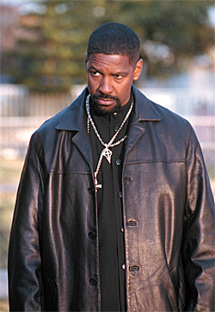
Unreported Crime (cont’d)
Victims may face fear, intimidation, or shame if they report a crime
Therefore, many will not report the crime right away or perhaps never at all.
Sometimes, they may not report the crime because they feel the cops won’t do anything or that they are corrupt.
Victims are often threatened with future violence if they report a crime to the authorities
Denzel Washington plays a
corrupt narcotics officer in
Training Day

Slide 9
Comparing Crime Rates
Especially high among 15-20 year olds
In recent years, males committed 4 times as many crimes as females
In over half of all crimes committed in the US in 2007, the victim claimed to know the offender in some way

Slide 10
How Does Crime Affect the General Public?
Monetary Costs
1) we spend up to 100 billion dollars a year in crime costs (federal, state, and local)
2) goes toward law enforcement, maintenance of prisons, court fees, etc.
A non-victimized family of four pays on average 1,500 dollars a year on crime taxes alone

